Slide 1

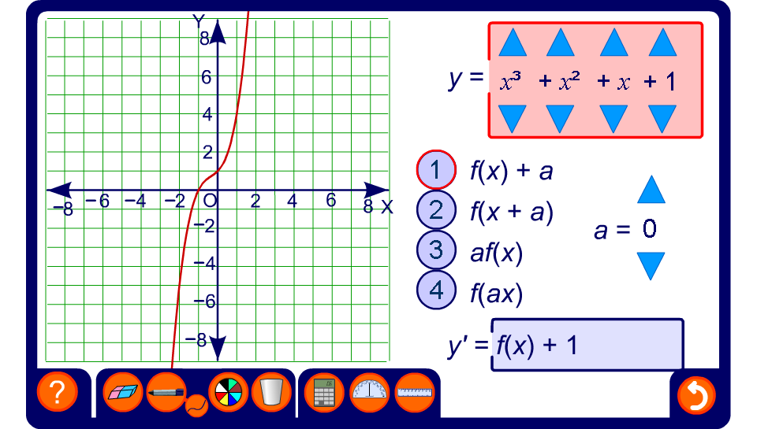


Transforming cubic functions
Notes:
Use this activity to investigate a variety of transformations applied to cubic functions.

